Slide 1
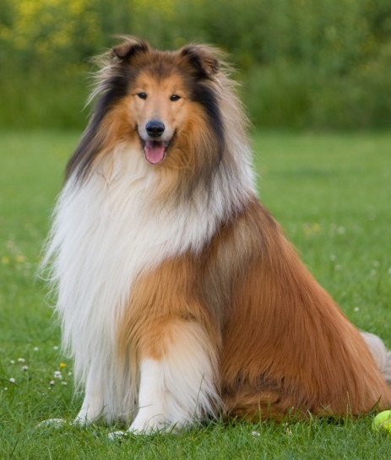
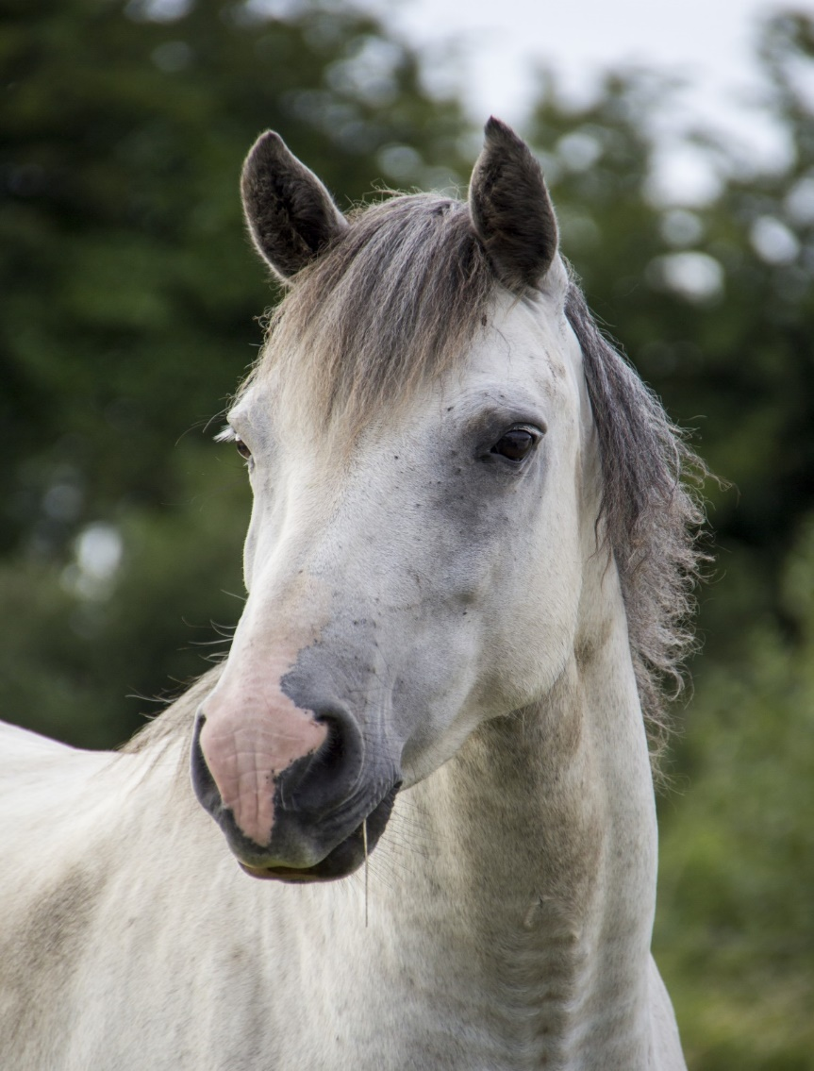

AUTOSHIP

Slide 2
Introduction to autoship

Slide 3

Introduction to autoship
What is Autoship ?
Allivet's Autoship & Save Program is used to ensure our customer's pets never run out of their medication.
Customers set up their autoship(s) we take care of the rest.
Customers do not need to remember to re-order their pet medications, food, treats, etc. as our system will automatically generate these orders for them.
If there is an error in the process of generating an autoship-order, one of our autoship specialists will take care of it.

Slide 4

Introduction to autoship
Why are autoships important ?​
Autoships are important because customers depend on us to get their pet medication in a timely manner. We will completely take care of the order.
Autoships will create loyal customers.
Pet will never run out of medication
Save Money with Autoship discount
Convenience

Slide 5
LIFE OF AN AUTOSHIP

Slide 6
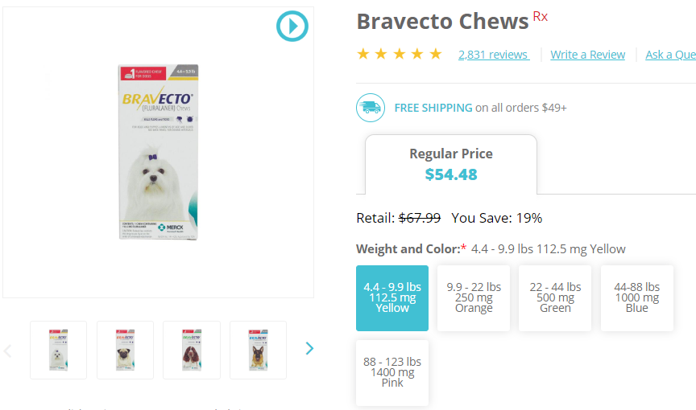
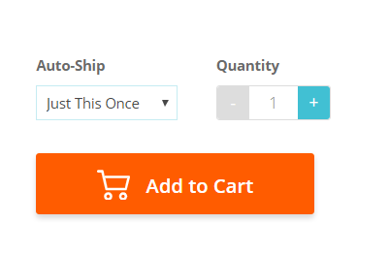
AUTOSHIP
Autoship Setup
How are Autoships created ?
Any OTC or prescription item can be added to autoship settings by selecting "Autoship" right next to the product description.

Slide 7
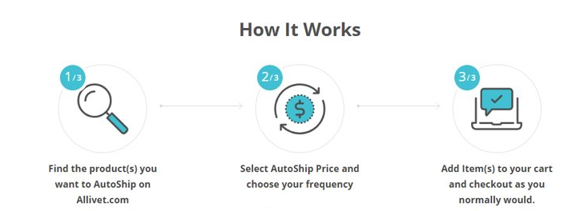
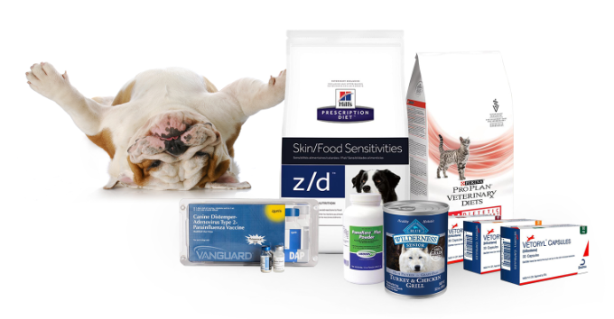

Slide 8
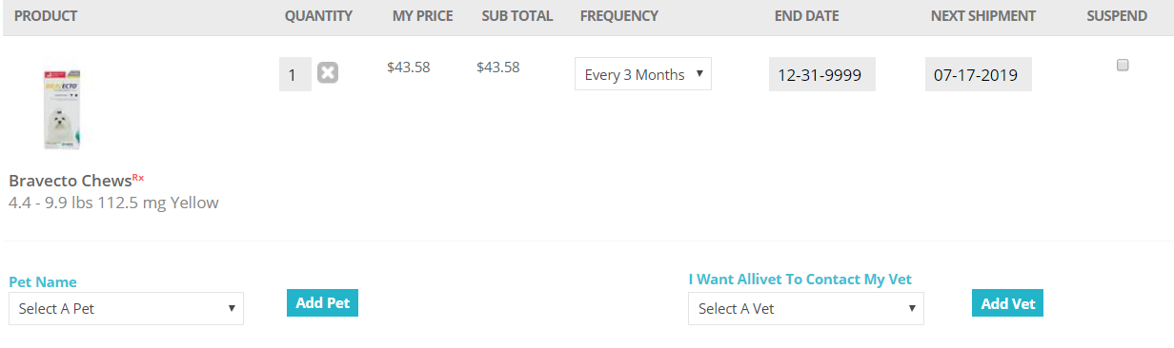
AUTOSHIP
Autoship Setup
Pet and veterinarian information must be selected under customer profile.

Slide 9
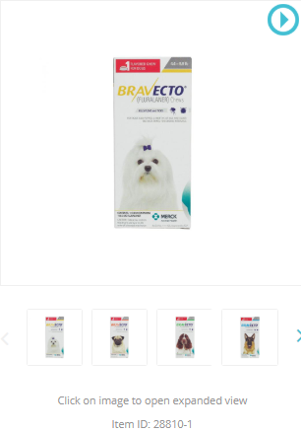
AUTOSHIP
Autoship Setup
When an agent is creating an autoship for a customer the following steps must be followed:
Obtain item # or product name

Slide 10
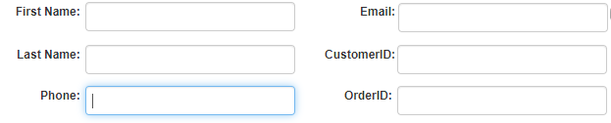
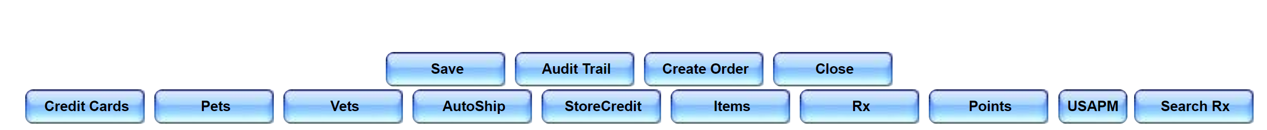
AUTOSHIP
Autoship Setup
Access customers account via customer manager ​
Select Autoship under radio buttons

Slide 11
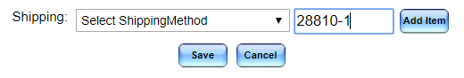
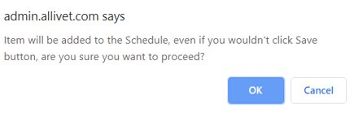
AUTOSHIP
Autoship Setup
Enter item # in empty box
Select Add item
Select "OK" to add autoship

Slide 12
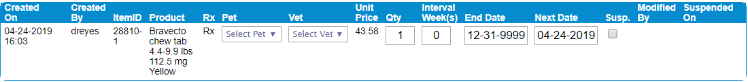
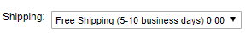
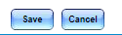
AUTOSHIP
Autoship Setup
Confirm pet and veterinarian information
Verify and select quantity and week intervals
Select shipping method
Click save ​
Autoships will not be saved unless all fields are completed.
Notes:
- Shipping policy still applies
- If item is priced $50 or above provide free shipping
- Confirm the next date
- End date can be selected if customer is concerned about commitment

Slide 13
Order flow

Slide 14

Autoship flow
Order Flow
How Autoship works
For every AutoShip order generated an email will be sent 3 days prior to the ship-by date and will include a list of the items scheduled to be shipped.
Customers have until midnight EST the day before to make any changes online.
The autoship is generated 3 days in advance to ensure receipt of a valid prescription and to allow for changes.
If an Autoship order has been generated and there is no valid prescription on file, one of our autoship agents will reach out to the veternarian for an approval.
If there are valid refills on file in the account, the autoship order will generate and ship the same day.
Autoship orders are our priority!

Slide 15
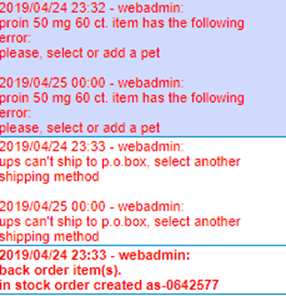
Autoships to place
This is the list of Autoship orders which the system attempted to generate but was unable to do so due to an error.
Autoship errors will reflect on the right-hand side in red and can be caused by:
Deceased Pet
Declined CC
P.O. Box Listed
Same Pet/ Same Item
No CC
Reward Points
Item on back order or out of stock

Slide 16
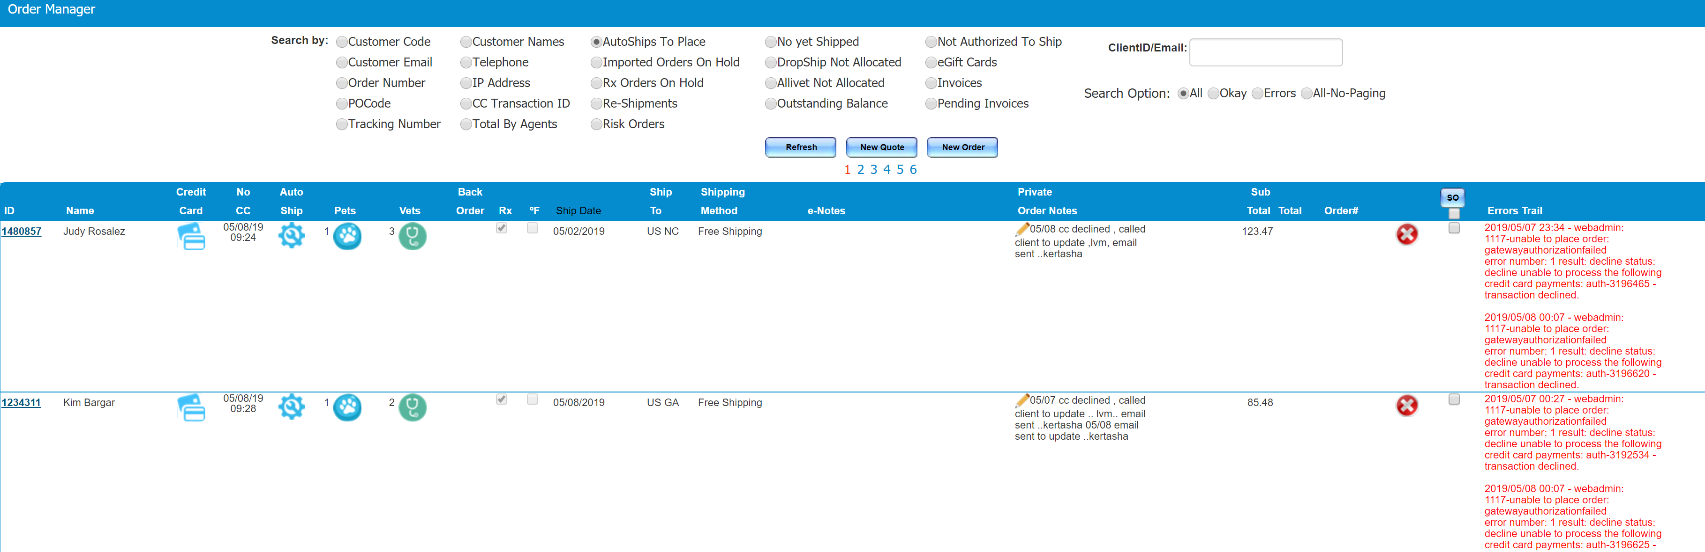
Autoships to place
Notes:
- Examples

Slide 17
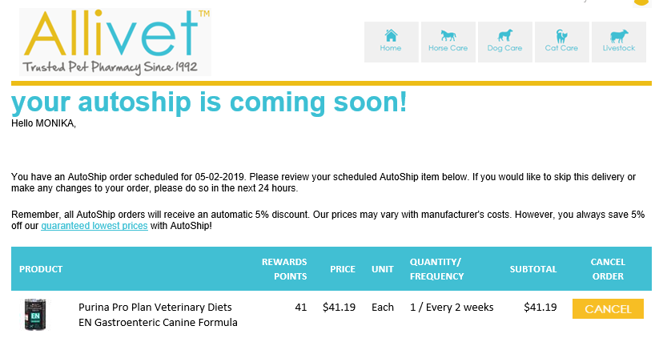
Autoships to place
Notes:
These are emails sent to customer when an autoship is coming

Slide 18
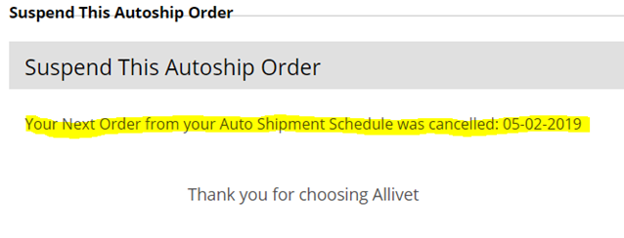
Autoship coming soon
Notes:
A customer has the option to cancel their upcoming autoship order by selecting " Cancel order " (previous slide )

Slide 19
What if ?

Slide 20
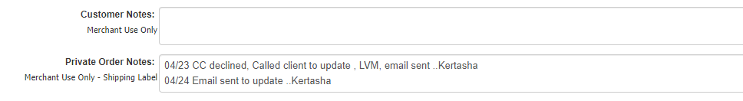
Autoship-fail
What if ?
The primary reason that an autoship does not generate is due to issues with the credit card.
In this case, an autoship agent will reach out to the customer to update the card information.
A note will be added to the customer’s account under “Private Order Notes”.

Slide 21
Autoship-fail
What if ?
If a customer is contacting us to generate their autoship order the following must be done : ​
Notes:
Agent is to ask customer for their information
Verify account information
Grab cust ID
Go to order manager "Autoship to place "
Find Customer
To generate cust ID will be selected and a new order will be created

Slide 22
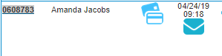
Autoship-fail
What if ?
If a customer is contacting us to generate their autoship order the following must be done : ​
Notes:
Agent is to ask customer for their information
Verify account information
Grab cust ID
Go to order manager "Autoship to place "
Find Customer
To generate cust ID will be selected and a new order will be created

Slide 23
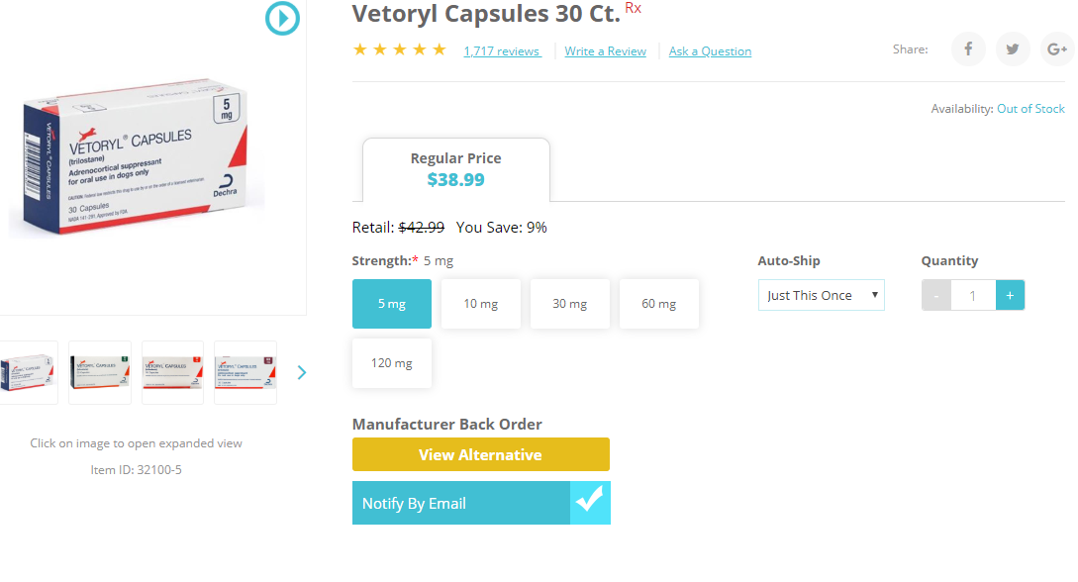
Autoship-fail
What if ?
Item on manufacturer back-order or out of stock:
Only available items on an order will be autoshipped.
Items on Manufacturer Back Order or Out of Stock will not be autoshipped.
Customer Service will be notified by the Warehouse Department should an item be out of stock and the customer will need to be contacted regarding their autoship order.

Slide 24

Autoship-fail
What if ?
Expired Prescription:
Autoship orders do not guarantee that the prescription will always be valid, as prescriptions expire one year after the written date.
If refills are not approved, a new prescription must be obtained in order to fulfill an autoship order.

Slide 25
Suspend autoship

Slide 26
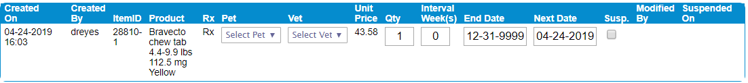
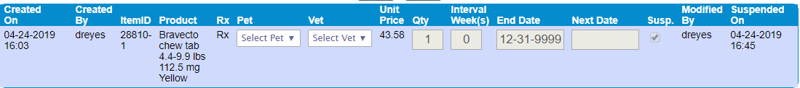
AUTOSHIP CANCELLATION
How to cancel an autoship
How to suspend an autoship:
There will be occasions where a customer requests to cancel an autoship.
As customer service agents we only able to suspend their autoship.
To suspend an autoship, simply select the Susp. Box next to the item.
Notes:
- Inform agents once an autoship has been suspended, a new one must be created

Slide 27
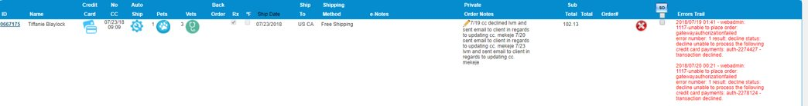
AUTOSHIP CANCELLATION
How to cancel an autoship pending order
Customers will receive an email notification 3 days in advance of a shipment.
Should they wish to cancel this pending autoship order, make sure to check under order history along with "AUTOSHIPS TO PLACE" .
Notes:
Agent will need to search under "Autoship to Place" using the CUST CODE
Once pending order has been located, the "X" must be pressed, in order to stop this order from generating

Slide 28
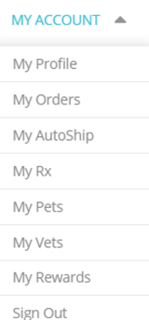
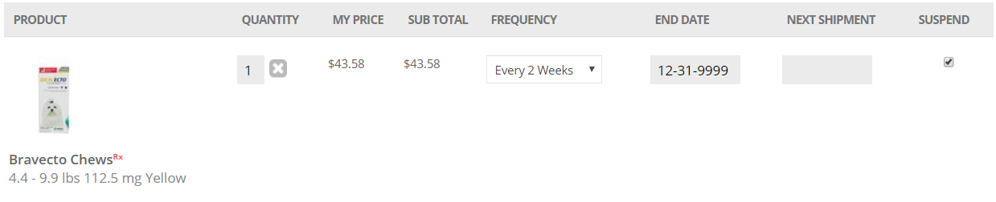
AUTOSHIP CANCELLATION
How to delete an autoship
How to delete an autoship:
Should a customer request to delete their autoship, they must log into their Allivet.com account and delete it.
They must locate " My Autoship" under the My Account dropdown menu
Select X
Notes:
- Try to suspend an autoship instead of deleting an autoship to help keep record

Slide 29
situations

Slide 30

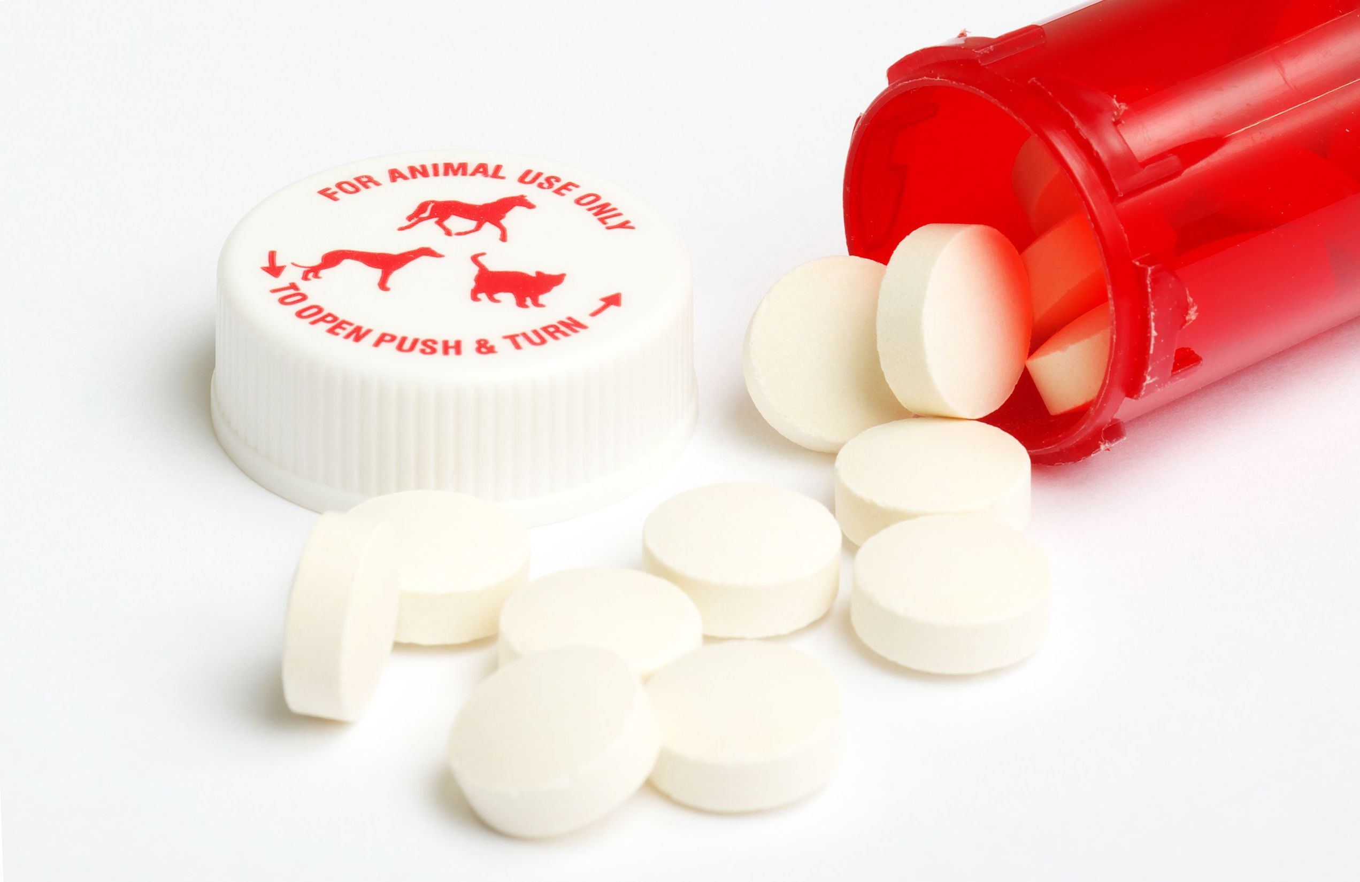
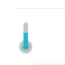
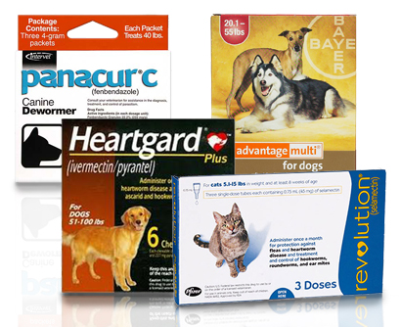
AUTOSHIP GENERATE
Too much medication
Occasionally customers will contact us to notify they have a surplus of medication that they would like to return.
How do we proceed?
Advise a refund request will be immediately submitted
Determine if product can be returned or donated/discarded
What items were purchased
Confirm if it’s a cold item
Confirm if items have been used/open
Notes:
- Determine if product can be returned or donated/discarded

Slide 31

AUTOSHIP GENERATE
Too much medication
There will be times when a customer forgets to suspend their autoship and an order generates. If they have a surplus and will not use them, we can assist them by doing the following :
Advise a refund request will be immediately submitted
Determine if product can be returned or donated/discarded
Create a return label if returnable
Offer to extend their autoship date, if they wish to keep package

Slide 32

AUTOSHIP GENERATE
Order did not generate
Should a customer inquire about an autoship not generating, check on "Autoships to Place" before creating a standard order.
If there are no pending orders under "Autoships to Place", an order must be created.
Create a standard order and apply the 5% autoship discount manually.
If pet is running short on medication expedited shipping is to be covered.

Slide 33

AUTOSHIP price
Autoship orders will be created with the regular item price and a discount of 5%
Autoship orders cannot be combined with coupons, discounts, or other offers except:
Reward Points
Store Credits
Price match previous orders upon request

Slide 34
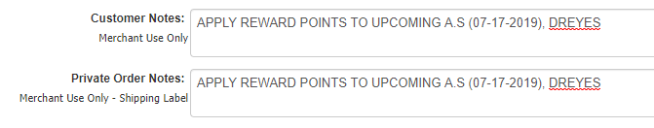
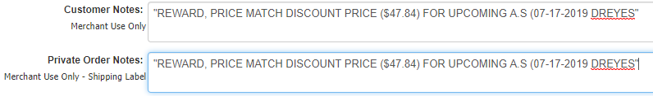
AUTOSHIP price
Notes must be placed on “Private Order Notes” regarding any changes made: ​
"APPLY REWARD POINTS TO UPCOMING A.S (DATE), INITIALS"
"REWARD, PRICE MATCH (AMOUNT $) FOR UPCOMING A.S(DATE), INITIALS "​
Notes:
-If customer requests to price match to previous order, and have an upcoming A.S they will make the notes above.

